Slide 1
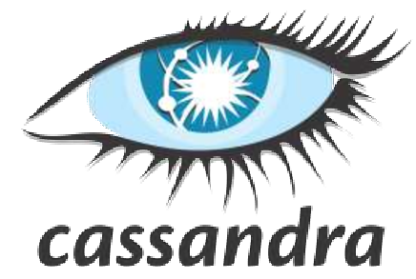
Apache Cassandra
CS5590- Big Data Programming
Fall 2018

Slide 2
Overview
Cassandra Introduction
Strengths
Architecture
Data Types
Commands

Slide 3
What is Cassandra?
Cassandra is the choice when developers need a scalability and high availability for the end user(s)
Features:
Best performance
Fault tolerant
No Single Point of Failure
Data replication and can be clustered into multiple data centers.

Slide 4
Why Cassandra?
It is an open source and developed Database management system that has the ability to handle very vast data
The data can be distributed over servers; the main importance of the Cassandra is to provide service which has no failure point
Cassandra can operate strongly on multiple data centres which are distributed over the World, along with replication which gives the Cassandra the ability to operate on low latency servers
Cassandra is used in “NetFlix, eBay, Twitter, Reddit and Many more”
While if we talk about the storage and nodes, then Cassandra documentation shows the highest setup of Cassandra is done, that consists of 400 TB of data distributed over 400 nodes

Slide 5
Cassandra Usage
One the most common use of Cassandra is in Facebook inbox Searching
Facebook stores approximately 150 Terabytes of its data on 150 nodes
Cassandra is also used in Twitter, Rackspace, CISCO and Many more

Slide 6
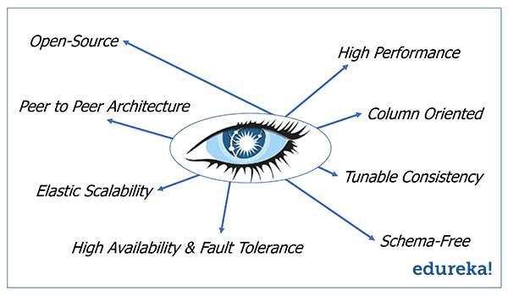
Strengths of Cassandra: Elastic and Scalable
The Cassandra is elastic and scalable because of the read and writes operations per second which increases linearly when a new node is added to the channel of Cassandra database’s seed machine
With no downtime or restarting needed for the configuration of the system, whenever node is added to the channel it starts operating straight away without the system to be restarted

Slide 7
Strengths of Cassandra : Reliable
When the developer was designing the Cassandra, in the development stage they expected that hardware may fail due to the unreliability
Cassandra now has the ability to abide more than one node failure. Whenever a node fails, it does not affect the main Cassandra application and no down time is observed at all.
These nodes can be replaced once the error has been removed or hardware has been replaced, and bring them back online in functioning state.
The termination of data that originates across the data centres across terrestrial regions caused by the data replication is supported by the Cassandra database.
All nodes in the Cassandra channel have same abilities with no node as a top priority node. Cassandra uses its feature known as accrual failure detector which is used to monitor the operation power of the nodes within a cluster.

Slide 8
Strengths of Cassandra : Durable & Without ETL
Durable
Writing is also known as durability, and once the writing process is completed that written data will remain on disk forever even if the hardware failure occurs
Same is the case with Cassandra, Cassandra writes records, and it appends those records to commit log initially and then for the flushing of data permanently to a disk it uses “fsync system call”
Analytics without ETL
There is one to one access to the execution of jobs of Hadoop that is feed in Cassandra and with no impact on the working of the applications that runs of the real time
ETL (Extract, Transform and Load)
ETL is a process in data warehousing responsible for pulling data out of the source systems and placing it into a data warehouse.

Slide 9
Architecture of Cassandra
Main Feature : Master and slave working of the whole setup of a system of a point to point cluster
The system doesn’t have any single peer failure
The system designed has no master node
If there is any failure in the node or if there are a lot of request sent by other peers this would not affect other nodes inside the cluster
The setup will continue its working normally as it was working before any point failure
The Cassandra has the ability to group many servers regardless of their figure
Cassandra has a very usable architecture which has the ability to perform thousands or millions of operations in a second
It has also the capability to handle the data that is in petabytes, which is distributed over a huge number of data centers; it can perform operations that are very small

Slide 10
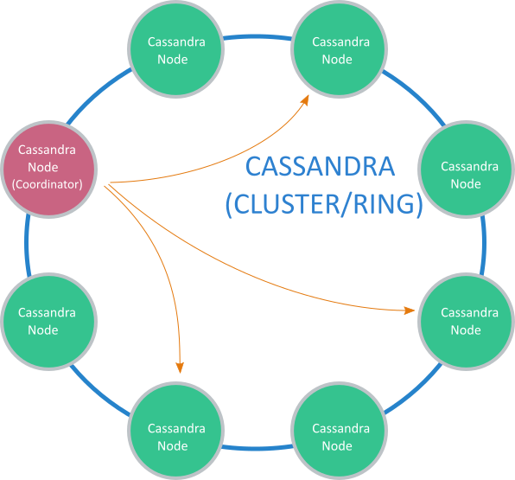
Distribution and Replication of Data
Workable Database Management System: The ability to provide the distribution of the data to the number of machines connected to the cluster or we can say in other words a ring in automatic format.
Distribution of Data is Automatic.
Distribution is in an ordered or random manner, but initially when Cassandra is installed and no settings are done, the data is distributed randomly over the machines connected to the cluster.

Slide 11
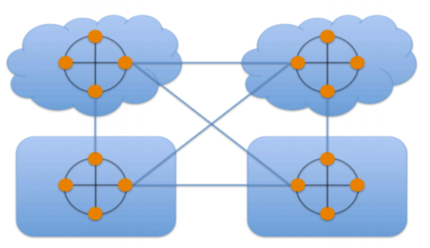
Multi Data Centre and Cloud Support
Cassandra is known as one of the most prominent NoSQL databse, when someone talks about the duplication of the data across different data centres or rack spaces.
For administrators or developers, it is very easy to handle and make only one Cassandra cluster, add as many nodes as they want. It can be configured from only one place rather than going to each and every node.
When data is provided, it automatically distributes the data across several data centres or hybrid cloud fashion.

Slide 12
When a developer intends to create a new Cassandra database in the cluster, he only has to use a simple command in the command line of Cassandra which is also known as creating a key space
During the creation of a key space in command line, the developer can tell how many and which nodes to be considered and how much should be the replication
After when he enters the command, it’s the Cassandra responsibility to control and distribute the data functionality and replication over the nodes that are in the cluster in automatic format

Slide 13
Reading and Writing Data
Cassandra provides architecture to the system if we talk about reading and writing of the information to the Cassandra cluster’s nodes, “which is independent on location”
It means that no one is aware of where the data has been written. This tells us that if there is any machine in the Cassandra ring, it will have the ability of reading and writing no matter if it’s in single cluster setup or multi cluster setup
This ability of Cassandra shows a true “read/write-anywhere design”

Slide 14
Data Consistency
Data consistency is the main feature of Cassandra which provides a good command over the flexibility of Cassandra. As discussed that Cassandra provides “tunable” data consistency for the Cassandra cluster, so the main flexibility is that a developer is a commander to decide what type of data consistency is required
This type of consistency is supported in the Cassandra’s clusters if they are in single or multiples data centres. The developer is now free to choose among the options of the data consistency which one is appropriate and which operation he wants to perform
Consistency can also be handled on the basis of a single operation, which means that a developer decides which operation should be performed on all nodes at one time. The operations may be INSERT, UPDATE, DELETE and SELECT

Slide 15
TYPE | CONSTANTS SUPPORTED | DESCRIPTION
Int | integer | 32-bit signed int
Smallint | integer | 16-bit signed int
Text | string | UTF8 encoded string
Time | integer, string | A time (with no corresponding date value) with nanosecond precision. See Working with times below for details
Timestamp | integer, string | A timestamp (date and time) with millisecond precision. See Working with timestamps below for details
Timeuuid | uuid | Version 1 UUID, generally used as a “conflict-free” timestamp. Also see Timeuuid functions
Tinyint | integer | 8-bit signed int
Uuid | uuid | A UUID (of any version)
Varchar | string | UTF8 encoded string
Varint | integer | Arbitrary-precision integer

Slide 16
TYPE | CONSTANTS SUPPORTED | DESCRIPTION
Ascii | string | ASCII character string
Bigint | integer | 64-bit signed long
Blob | blob | Arbitrary bytes (no validation)
Boolean | boolean | Either true or false
Counter | integer | Counter column (64-bit signed value). See Counters for details
Date | integer, string | A date (with no corresponding time value). See Working with dates below for details
Decimal | integer, float | Variable-precision decimal
Double | integer float | 64-bit IEEE-754 floating point
Duration | duration, | A duration with nanosecond precision. See Working with durations below for details
Float | integer, float | 32-bit IEEE-754 floating point
Inet | string | An IP address, either IPv4 (4 bytes long) or IPv6 (16 bytes long). Note that there is no inet constant, IP address should be input as strings

Slide 17
SimpleStrategy vs NetworkTopologyStrategy
SimpleStrategy is for data, that can be manageable within some limits such as the data would be text only or limited types of images.
NetworkTopologyStrategy is for data such as High quality images and videos which had to travel through the network and data will be distributed among different clusters.

Slide 18
Replication Factor
Replication factor is the strategy in Cassandra which makes replicas in nodes around the cluster to ensure reliability and scalability.
The total number of replicas around the clusters is referred to as Replication Factor.

Slide 19
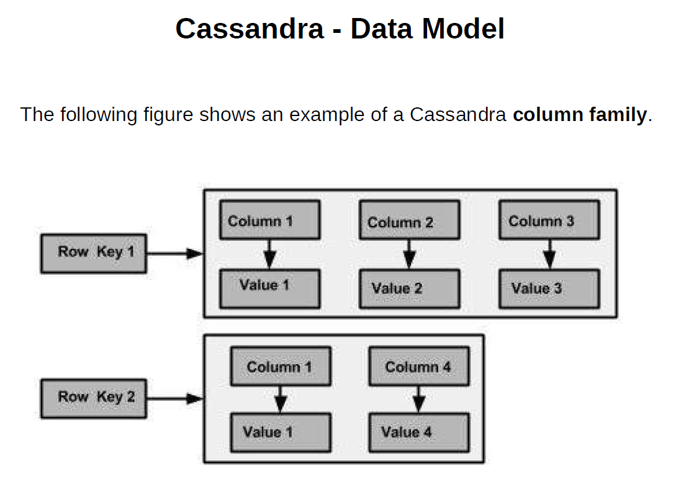

Slide 20
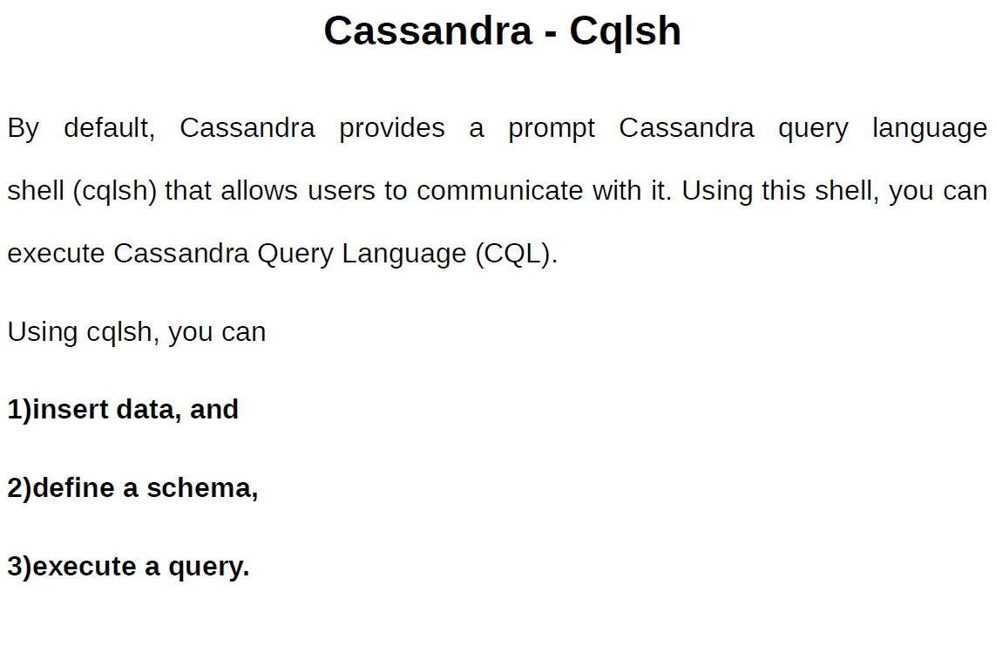

Slide 21
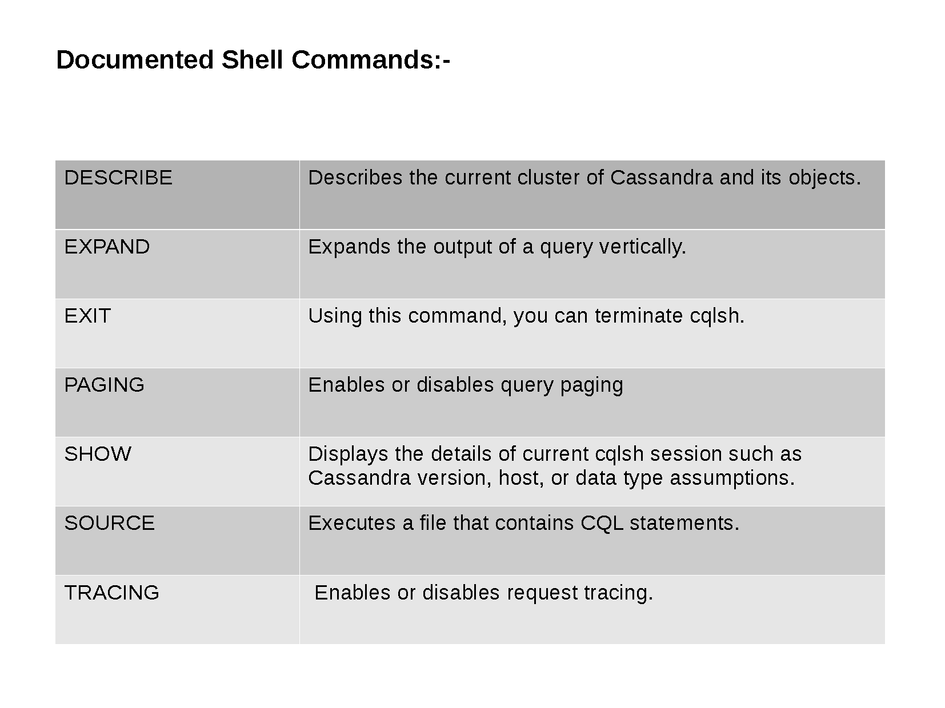

Slide 22
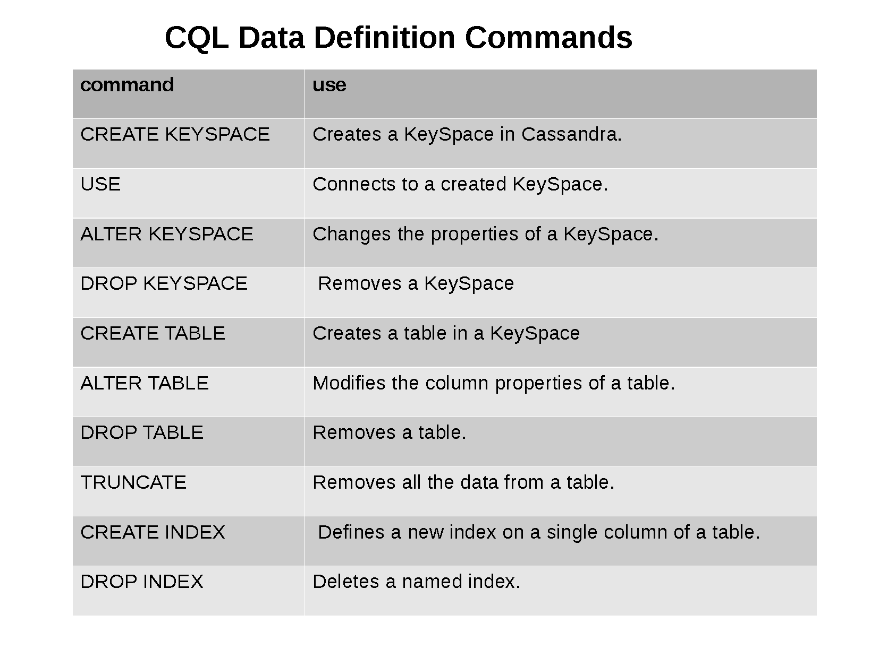

Slide 23
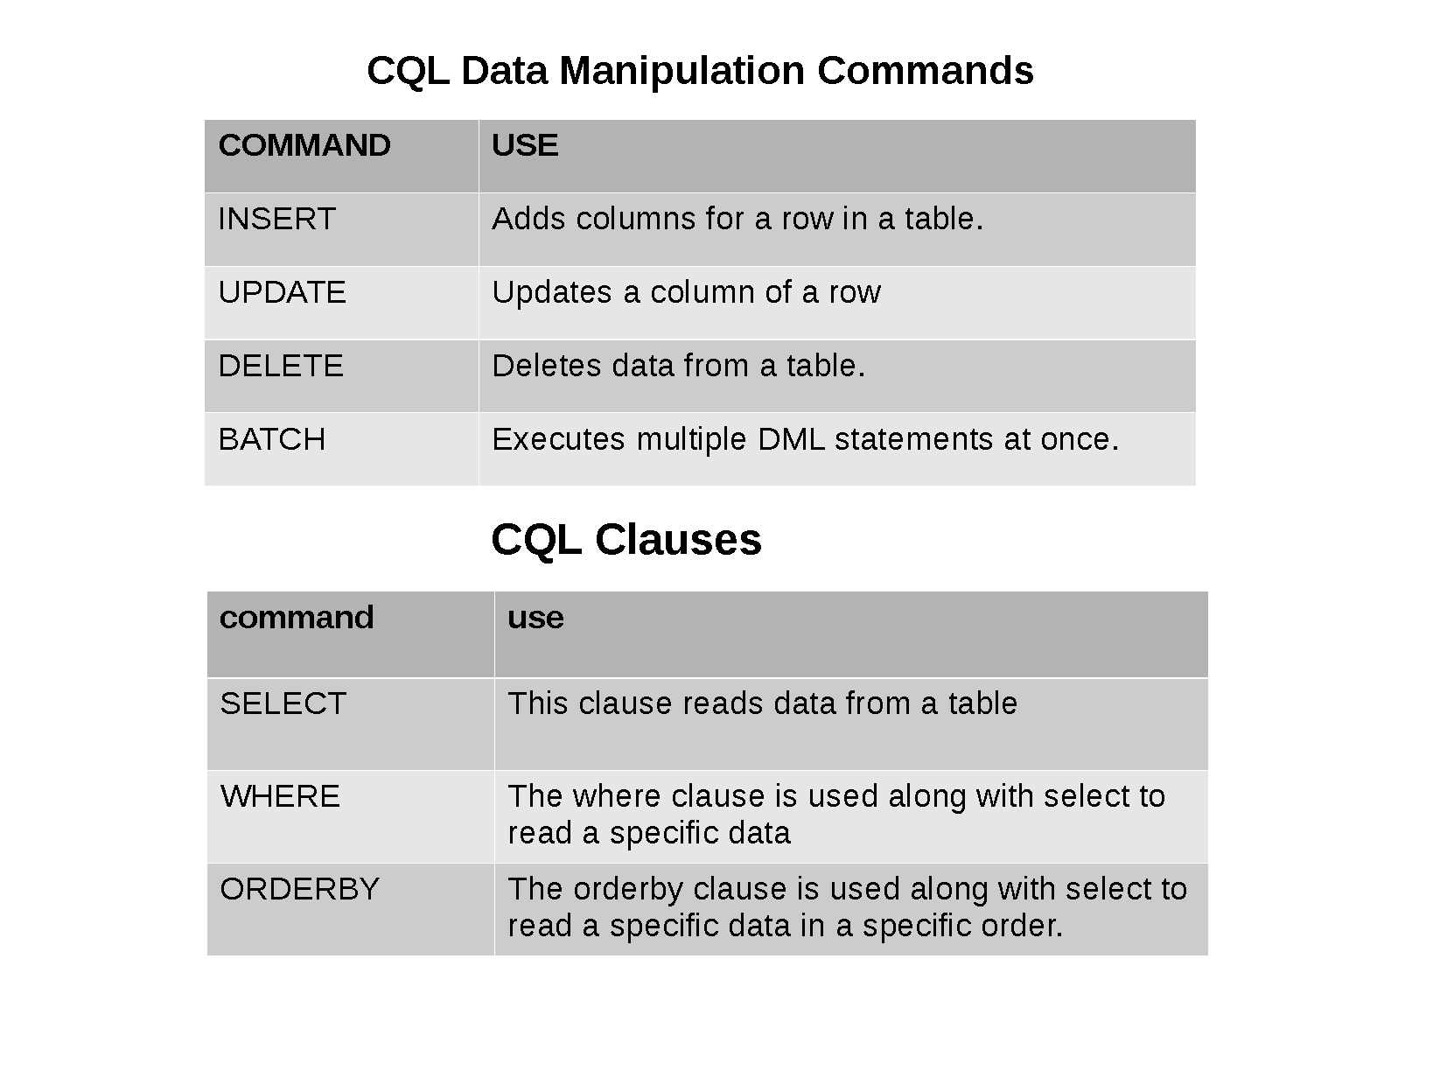

Slide 24
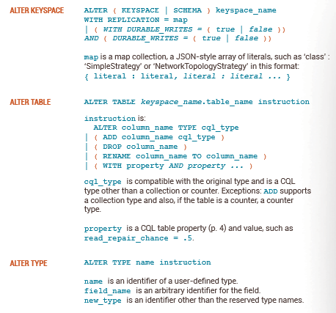
ALTER

Slide 25
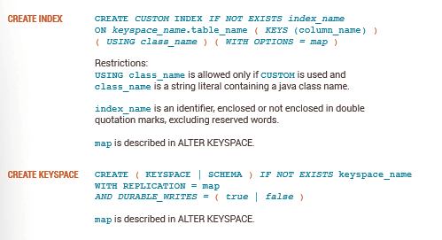
Creation of Index and Keyspace

Slide 26
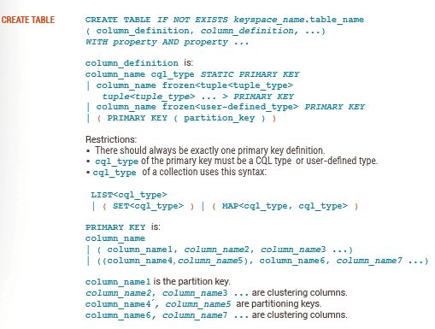
Creation of Table

Slide 27
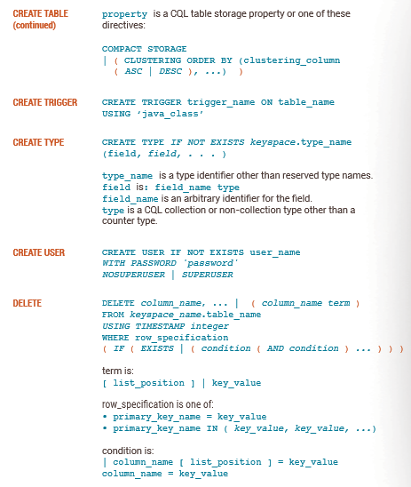
Creation of Table, Trigger, Type and User

Slide 28
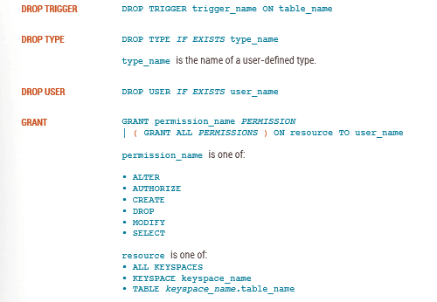
Delete / Drop
Permission Specification

Slide 29
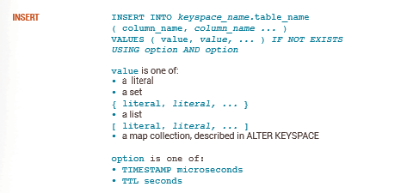
Insert Command

Slide 30
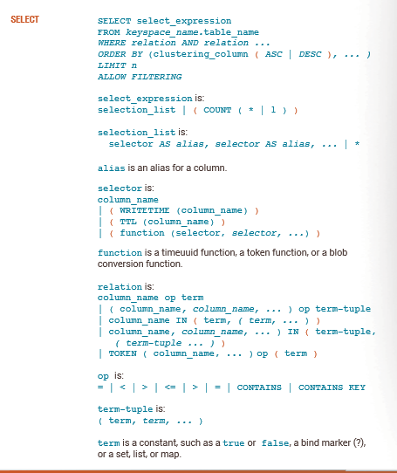
Select Command

Slide 31
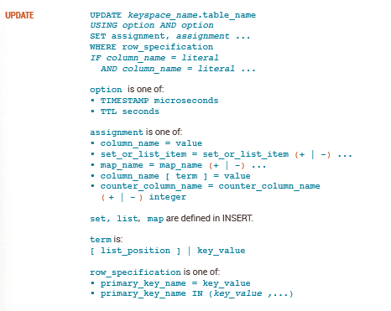
Update Command

Slide 32
Creating Keyspace
create keyspace bigdata with replication={‘class’:’SimpleStrategy’, ‘replication_factor’:1};

Slide 33
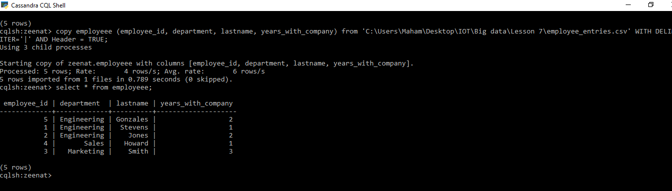
File Import

Slide 34
References
https://downloads.datastax.com/#ddac
https://www.datastax.com/blog/2015/06/datastax-community-217-and-2016-ready-download
https://www.datastax.com/blog/2012/01/working-apache-cassandra-mac-os-x
https://www.datastax.com/blog/2012/01/getting-started-apache-cassandra-windows-easy-way
https://www.guru99.com/cassandra-architecture.html
http://cassandra.apache.org/doc/latest/

Slide 35
Issues References
https://issues.apache.org/jira/browse/CASSANDRA-8222
https://stackoverflow.com/questions/27004773/cassandra-cqlsh-unable-to-connect-to-any-servers-127-0-0-19160-closed-is-a
https://www.vitalsofttech.com/tried-connecting-to-127-0-0-1-9042/

